Slide 1

R Best Practices: Session 1
Exploring NLP

Slide 2
What is NLP?
Natural Language Processing (NLP)
An AI field that focuses on the interaction between computers and human language
It involves developing algorithms/models to help machines understand, analyze, interpret, and generate human language
REAL WORLD USES
Chatbots
Translation Software
Speech Recognition
AI Tools
Market Analysis
Autocomplete
Grammer Checkers
Email Classification

Slide 3
How IS IT USED?
What is it used for?
Clean Up, Organization, Categorizing
Text Tokenization – turning a block of text into individual words/phrases
Part-of-Speech Tagging – assigning grammatical categories to words in a sentence
Named Entity Recognition (NER) - identify and classify entities (names, locations etc.)
Interpretation
Sentiment Analysis – determining meaning/emotion expressed in a text
Topic Mapping – figuring out what topics are being emphasized in a certain text

Slide 4
Quick Detour: What is Tidy DatA?
A clean/organized way to arranged data so that it can be analyzed efficiently/effectively
Has become best practice to keep your code tidy as much as possible
Key features
Each variable has a column
Each observation has a row
Each observational unit is in a table

Slide 5
How Does it Work?
Step 1: Tidy up the data
Convert strings/sentences/chunks of text into tidy data
Create meaningful chunks either of single words or n-grams (2+ words)
Edit the text and remove unnecessary elements such as punctuation and stop words (of, to, the)
Add in descriptive columns to help organize the data
Step 2: Basic Summarization (dplyr, ggplot)
Get a count of most common words
Add basic visualizations/distributions
Step 3: Explore/Analyze/Learn

Slide 6
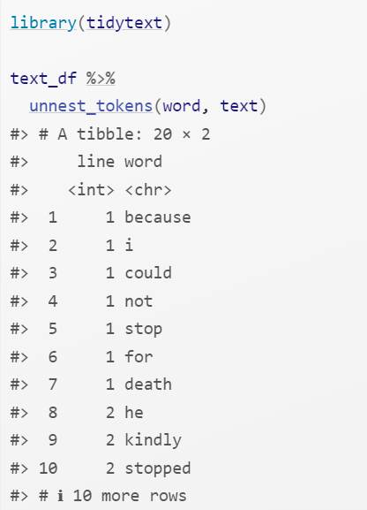
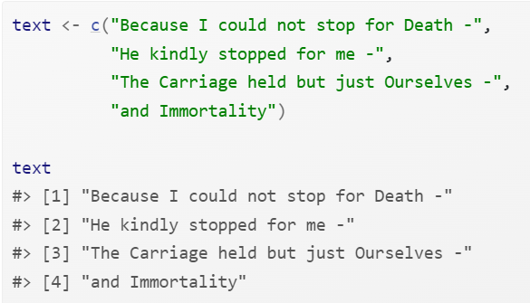
Example of Cleaning Text
Tidy Text
Untidy Text

Slide 7
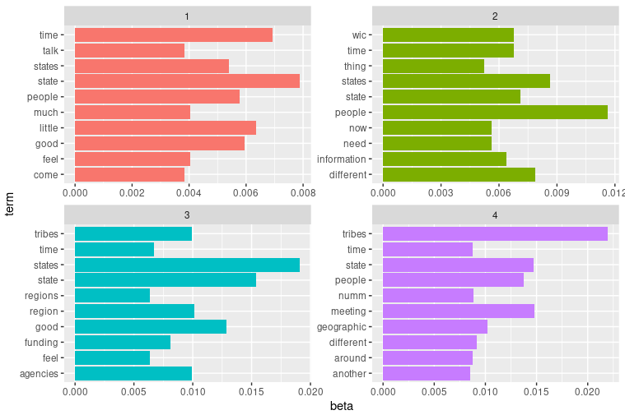
Topic Modeling
What is it? Topic models are statistical models that discover similar abstract "topics" across documents by grouping words together.
There are several approaches to topic modeling in ML and NLP Here are some of the main techniques:
Latent Dirichlet Allocation (LDA):
Most popular probabilistic topic modeling method
Assumes documents are mixtures of topics and topics are mixtures of words
Available in R through packages like 'topicmodels' and 'lda'
Non-Negative Matrix Factorization (NMF):
Factorizes the document-term matrix into two non-negative matrices
Can be implemented using the 'NMF' package in R
Latent Semantic Analysis (LSA):
Uses singular value decomposition (SVD) on the document-term matrix
Available through the 'lsa' package in R
Correlated Topic Models (CTM):
Extension of LDA that allows for correlation between topics
Can be implemented using the 'topicmodels' package
Structural Topic Models (STM):
Allows incorporation of document metadata into the topic model
Available through the 'stm' package in R
Hierarchical Dirichlet Process (HDP):
Non-parametric Bayesian approach that automatically determines the number of topics
Can be implemented using the 'rhdp' package
Dynamic Topic Models (DTM):
Extends LDA to capture topic evolution over time
Available through the 'ldaseqmodel' package
Here is a sample using uncleaned Teams transcripts from KIIs and an LDA approach.
Notes:
ML = Machine Learning
NLP = Natural Language Processing KIIs = Key Informant Interviews
See sample codes: Sept 2024 - NLP Foundations

Slide 8
nlp with copilot
A-G now has commercial data protection for Copilot
Can be used to summarize publicly-available or non-sensitive data (i.e., no personal data or PII) – still want to use caution
Here are the primary takeaways from the survey data:
Positive Feedback: Many participants appreciated the collaborative activities, interactivity, and engagement with colleagues. Specific mentions include the BHAG introduction, Kevin Shea’s remarks, and the creativity of the activities.
Areas for Improvement: Some participants felt the activities could be more FNS-specific and relevant to their work. There were suggestions for more time to discuss issues with immediate teams, better instructions for activities, and more real-life examples.
Mixed Reactions: While some found the sessions inspirational and thought-provoking, others felt they were too abstract or not directly applicable to their work. There were also comments about the length of the day and the need for more breaks.
Logistical Feedback: Participants appreciated the outdoor lunch and grab-and-go meal options. However, there were comments about the temperature of the room and the need for more food.

Slide 9
Using ai for coding
Be specific when initially prompting
E.g., “Write an R code to use tensorflow and tidyverse best practices to do NER on text”
Feel free to use for troubleshooting / errors also, but isn’t perfect – helpful, though!
Never plug company data into online AI tools (other than Copilot when you have commercial data protection through your A-G account – still, be cautious, don’t input sensitive data)

Slide 10
Resources for LEarning NLP
https://www.geeksforgeeks.org/natural-language-processing-with-r/
a good quick read that will give you a wide breadth of knowledge without being overwhelming
https://www.tidytextmining.com/
great for learning basics as well as specifics about the tidytext package
https://guides.library.upenn.edu/penntdm/r
walks through different NLP packages and details what each one has to offer
https://www.kaggle.com/code/rtatman/nlp-in-r-topic-modelling
a more step-by-step example of analyzing data and how that flow works

